Slide 1
Amazing data from MovieLens
Team 2
Hang Ding Fangling Zhang
Qingquan Zhao Yihao Zhou
Tongge Zhu

Slide 2
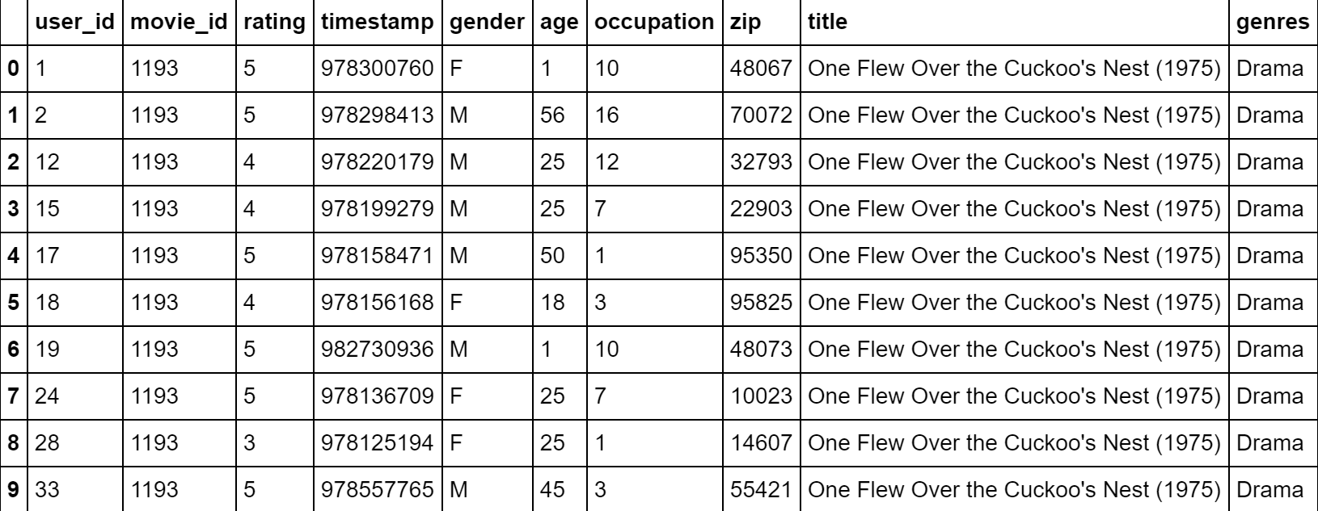
This is how we start...
Importing the MoviesLens data set and merging it into a single pandas dataFrame

Slide 3
Some basic details of the data
29 movies have an average rating over 4.5 overall.
29 movies have an average rating over 4.5 among men, 70 movies have an average rating over 4.5 among women.
105 movies have an median rating over 4.5 among men over age 30, and 187 movies have an median rating over 4.5 among women over age 30.

Slide 4
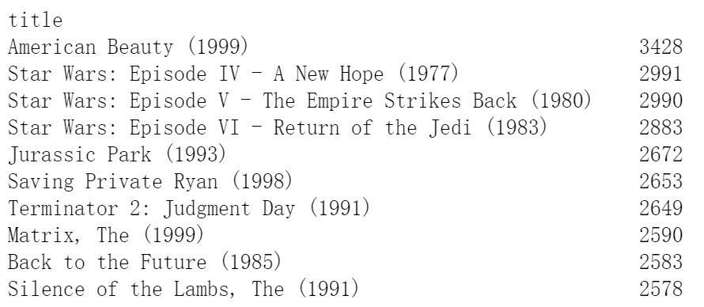
Ten top rating times movies
Top rating = Most popular ✔️

Slide 5
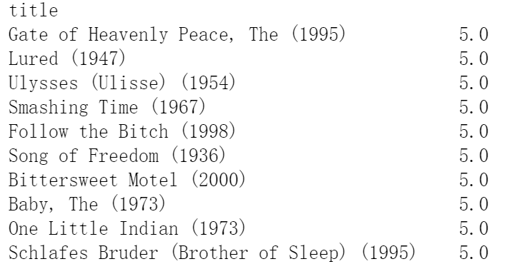
Ten top rating movies

Slide 6
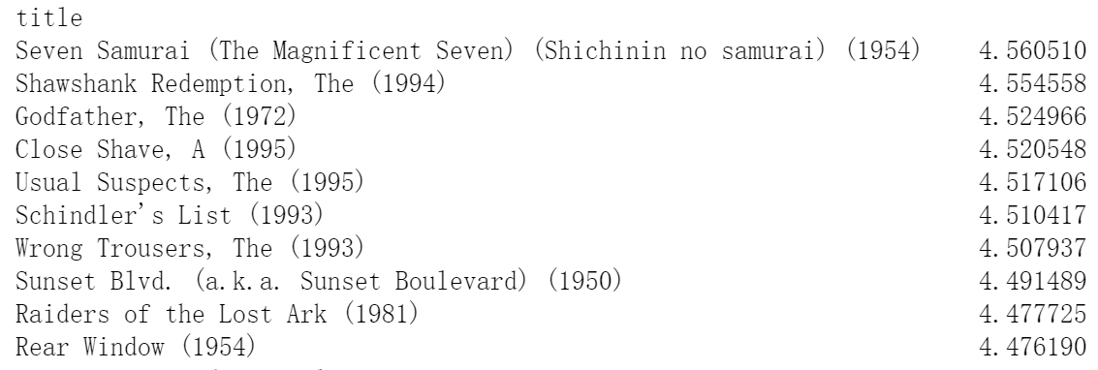
Ten top rating for movies which are rated more than 100 times.

Slide 7
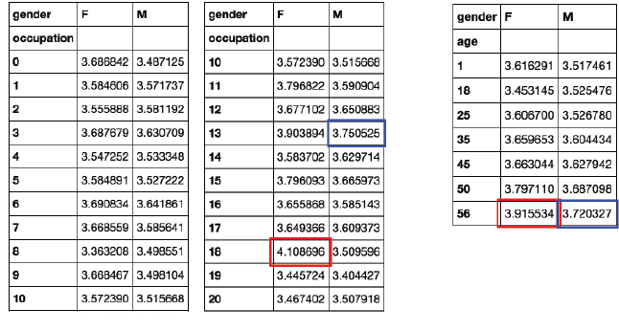
How easy various groups are to please?
13 - retired
18 - tradesman/craftsman

Slide 8

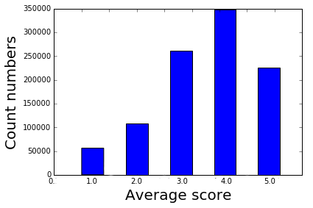
Expand our investigation to histograms

Slide 9
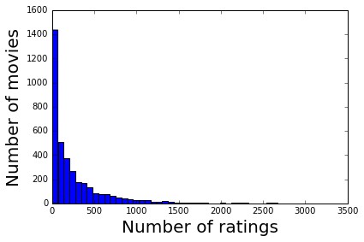
The number of ratings each movie received
The plot clearly shows an exponential relationship between number of movies and number of ratings, thus suggesting only a small portion of movies received a large amount of ratings, and most movies received less than 500 rating times.

Slide 10
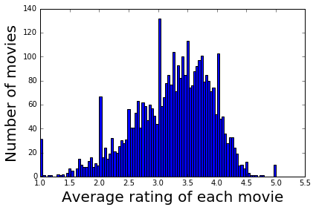
The average rating for each movie

Slide 11
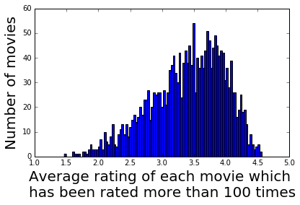
The average rating for movies which are rated more than 100 times.

Slide 12
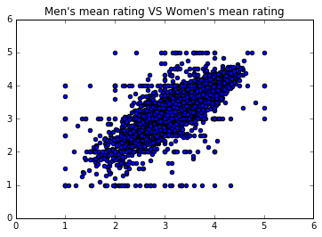
Mean rating for every movie men versus women
Problem 3

Slide 13
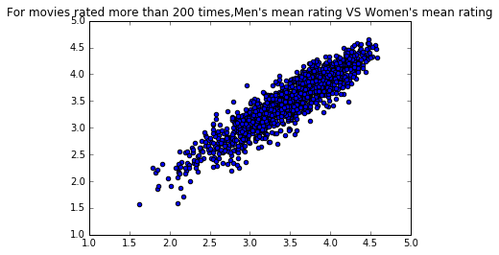
Mean rating for movies rated more than 200 times men versus women

Slide 14
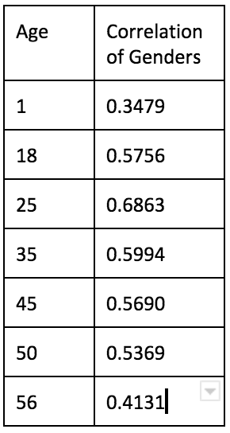
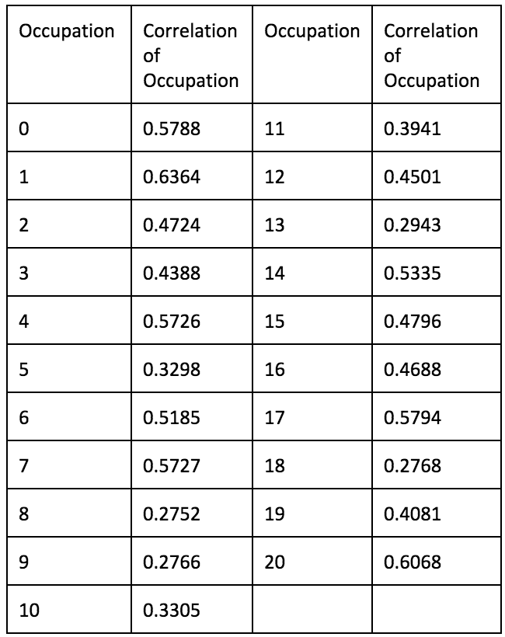
Correlation coefficient

Slide 15

Business questions
1. If we have a new movie, what should we do for best advertising?
To whom? Where?
2. Can we predict rating for a new movie. What kinds of factors impact people’s scoring?

Slide 16

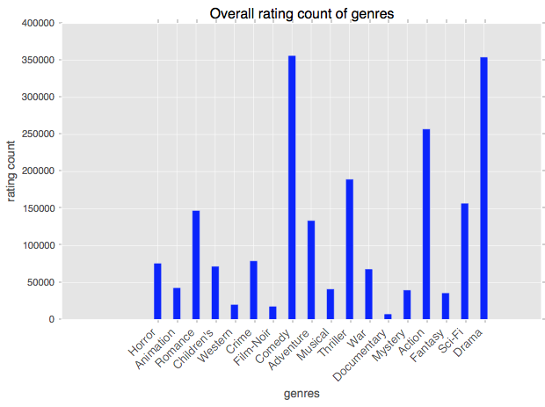
Rating count of Genres

Slide 17
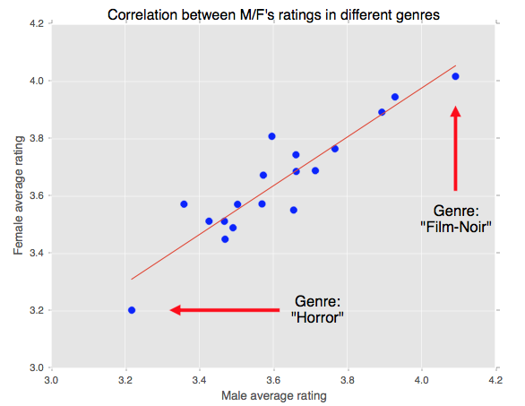
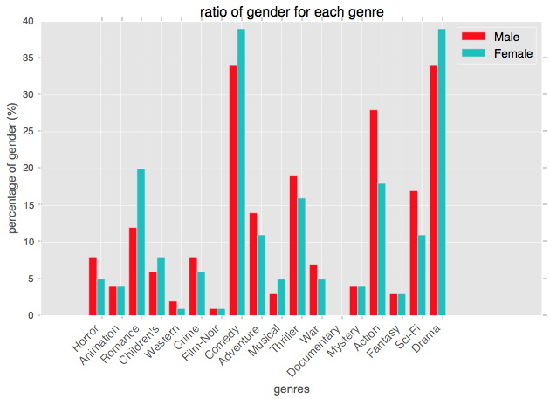
The similarities and differences
between
Male and Female raters

Slide 18
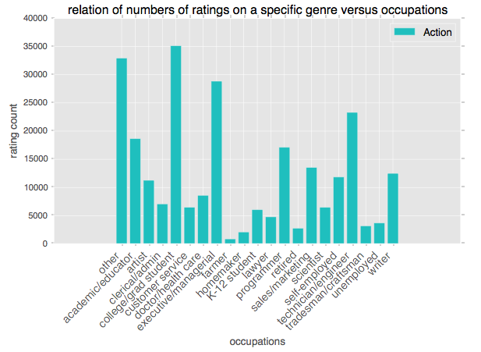
Different occupation’s behaviors

Slide 19
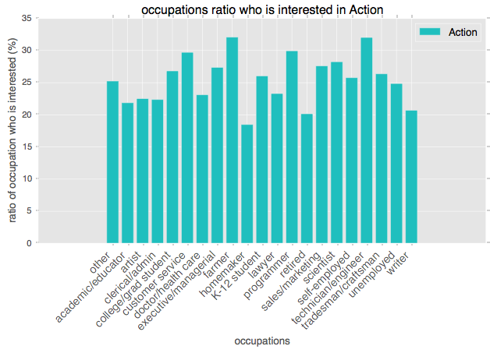
Rating counting of each occupation in Action movies
over 30% of farmer raters are talking about Action movies, even more than college/graduate student, who has the largest number in the previous figure. From this, we have to say if our new movie is an action movie, we probably need to take both factors into considerations.

Slide 20
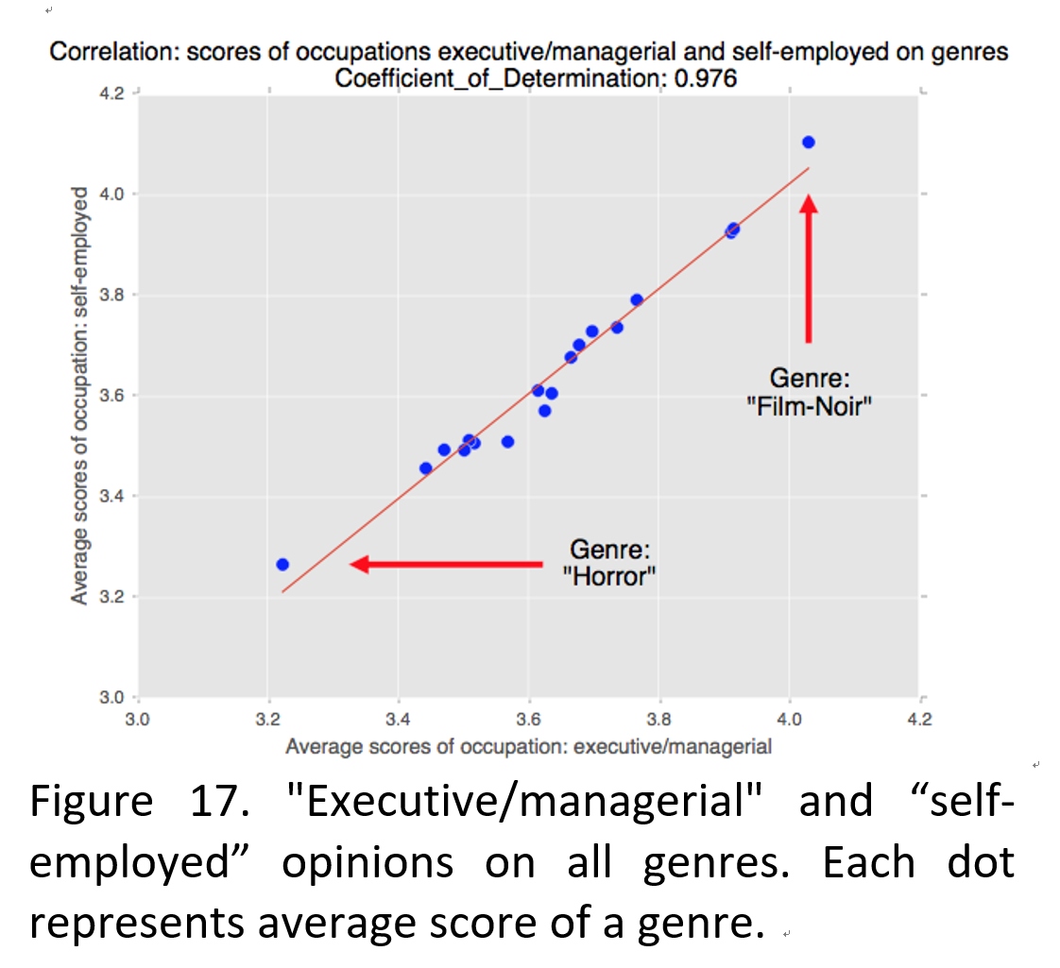
Correlation between different occupations

Slide 21
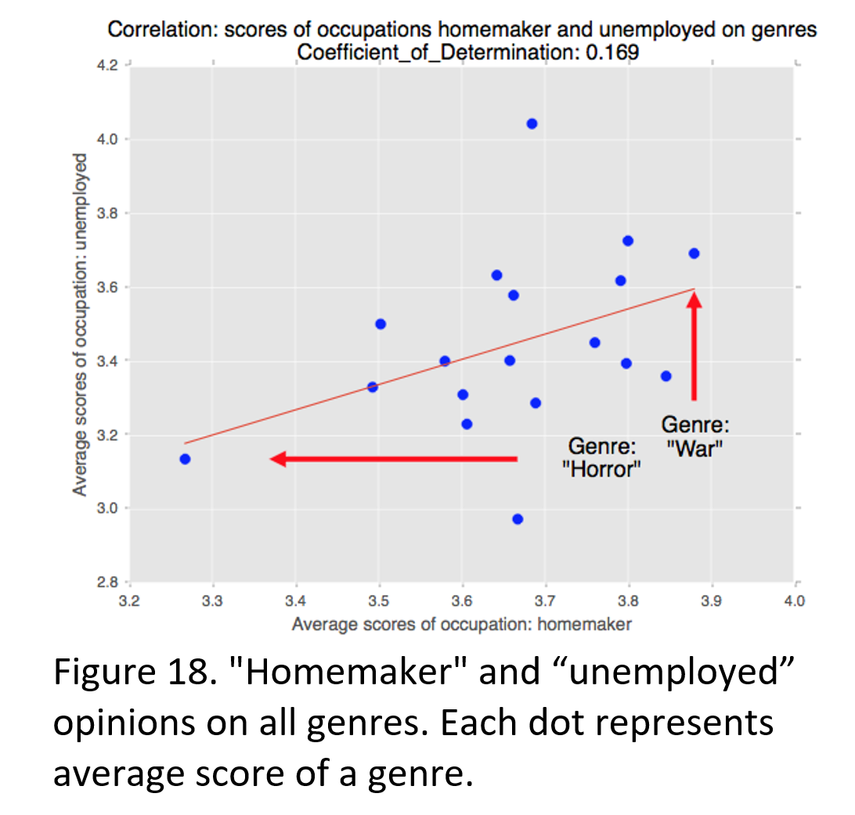
Correlation between different occupations

Slide 22
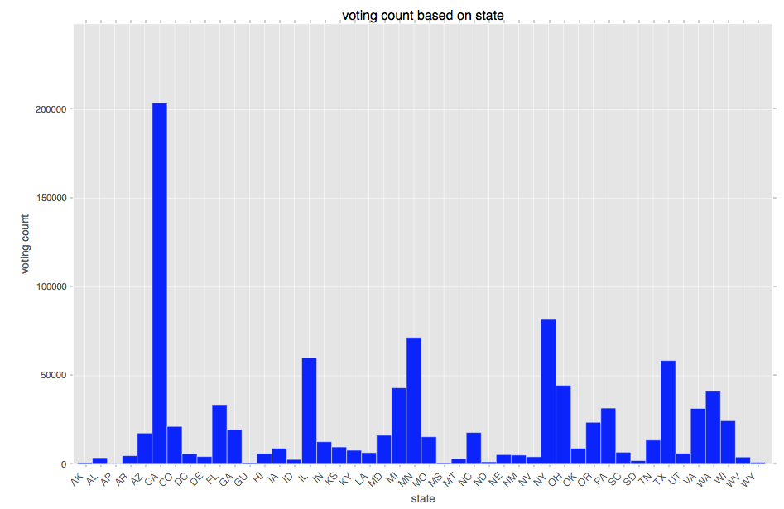
Locations: Where to advertise？
The Voting count of each state

Slide 23
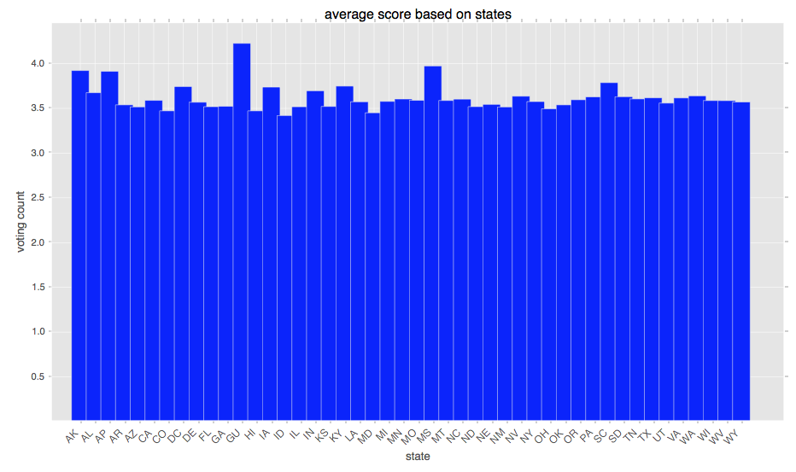
The average score of each state

Slide 24
Supervised machine learning on each movie’s features K-NN & SVM Predict if a new movie that has these features falls into different class of ratings..
Solution for Questions 2 (Supervised Machine Learning)

Slide 25
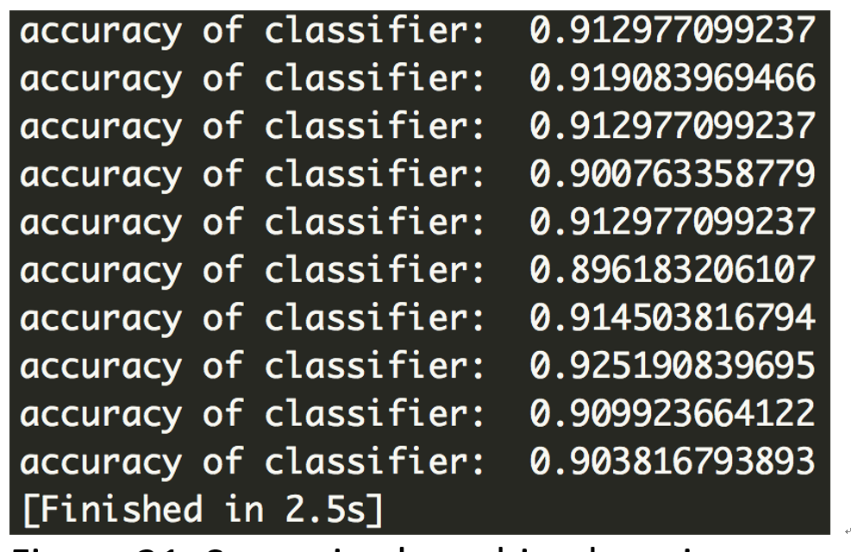
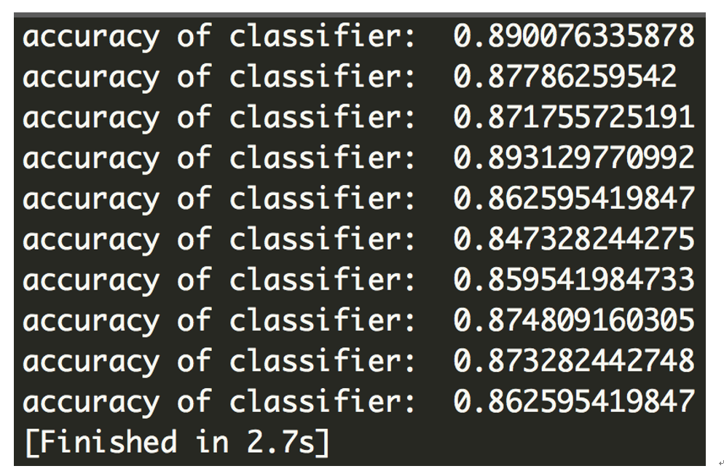
Accuracy of Supervised ML
Two classes：
>=4.0
<4.0
Three classes：
>=4.0 : Good
4.0> ~ >=2.0 : Average
<2.0: Bad

Slide 26
Answer for Questions 2
If we have a new movie and all features defined here, we can roughly predict where this movie’s score should be located.

Slide 27

Thank you

